Slide 1
Reflection of Light from a Convex Mirror

Slide 2
When you have completed this lesson you should be able to:
Understand the behaviour of three principal rays drawn when creating a ray diagram.
Draw ray diagrams for the reflection of an object from a convex mirror.
Describe the nature of the image produced by a convex mirror given the location of the object.

Slide 3
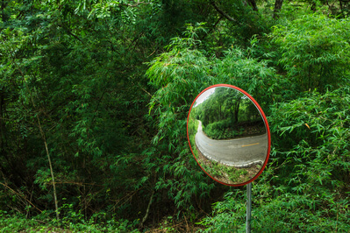
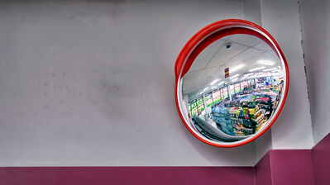
There are many uses of convex mirrors in everyday life.
When you enter a store, there is often a convex mirror placed in such a way that the store owner can observe everything going on in the store while staying at the counter. These security mirrors show an image of the store that is smaller than the store itself.
If you drive on roads that have a sharp corner, there is often a convex mirror placed along the corner. This convex mirror allows you to observe any oncoming traffic even though the image of the corner is smaller than the corner itself.

Slide 4
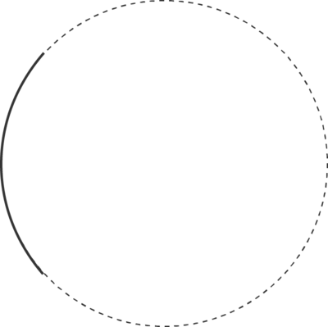
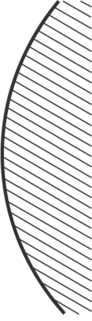
A convex mirror can be identified by the outward curve of the mirror.
When drawing convex mirrors it can be useful to think of the mirror as part of a large circle. This will make sure that the drawn mirror has the correct degree of curvature to it. It is also standard to shade the non-reflecting side of the mirror, as shown in the diagram below.
The non-reflecting side of a convex mirror is the inside of the greater circle the mirror is part of.

Slide 5
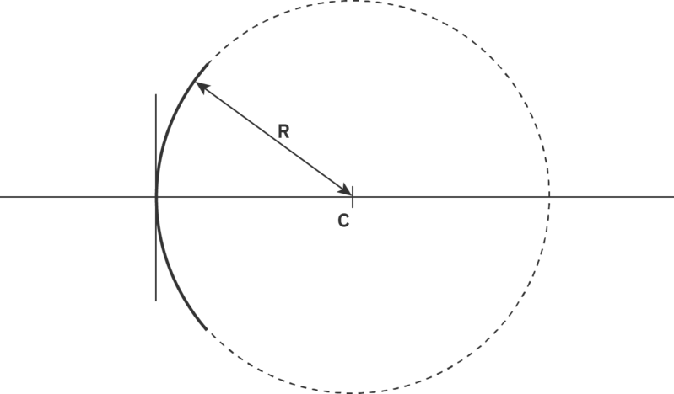
The larger circle that convex mirrors are part of can help identify properties of the mirror.
We can define the centre of this large circle as the centre of curvature of the mirror, denoted by the letter C. The distance between the centre of curvature and the edge of the mirror is defined as the radius of curvature of the mirror and is represented by R (which can be written in either upper or lower case).

Slide 6
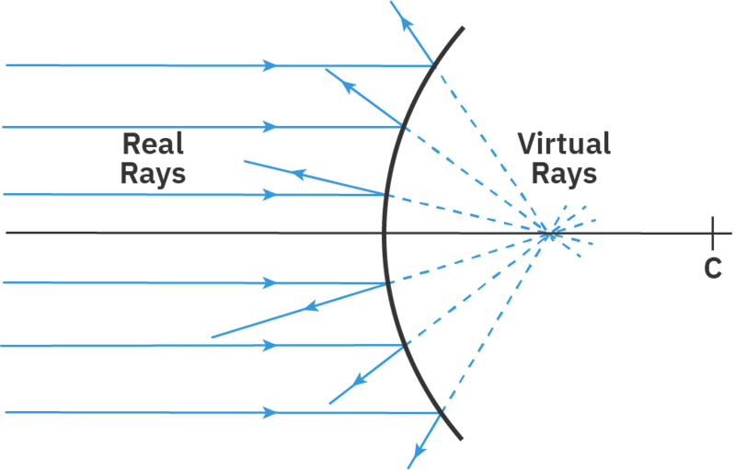
A convex mirror is a type of diverging mirror.
This means light rays coming from a distant source (which are considered to be parallel to each other) hit the mirror, and get reflected outward (spread away) from the mirror.
We can trace these reflected rays behind the mirror, to show them all converging on one spot. This shows where the reflected light rays appear to have come from.
When we trace light rays behind a mirror, we draw them as dotted lines. This helps us identify them as virtual light rays (as they cannot travel behind the mirror in reality).

Slide 7
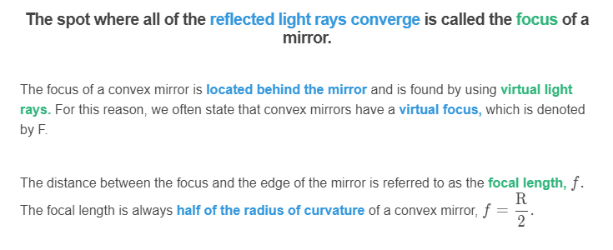
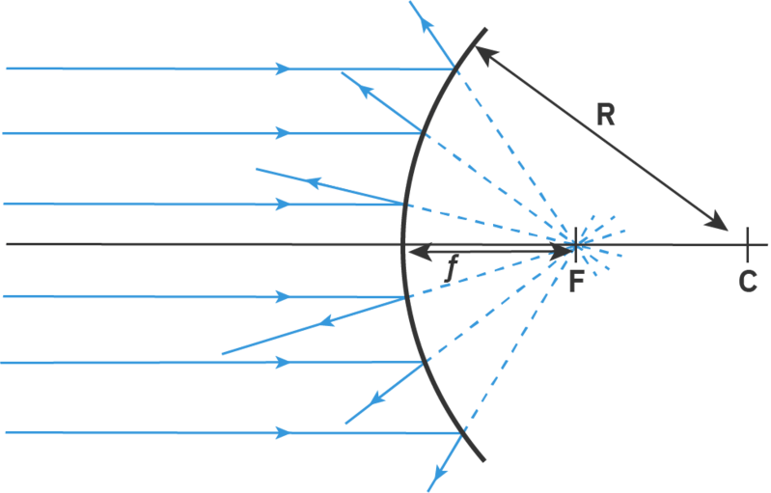

Slide 8
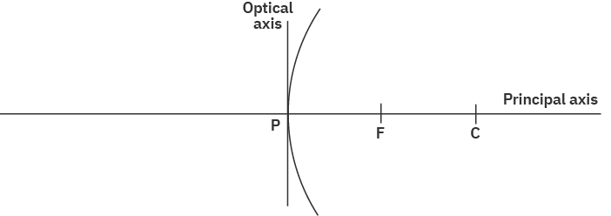
A ray diagram is a drawing which can be used to describe the image formed by a convex mirror.
To draw a ray diagram we first need to draw some axes. The first of these is called the principal axis and consists of a horizontal line. The second axis is called the optical axis and it approximates the convex mirror as a vertical straight line. The optical axis is often placed near the middle of the principal axis.
The intersection between the principal and optical axes is referred to as the pole (or centre) of the mirror and it is denoted by a P. Other properties of the mirror can also be included along the principal axis (e.g. the centre of curvature and the focus). The horizontal and vertical scales of ray diagrams do not have to be the same. In fact, the vertical scale is often much more magnified than the horizontal scale, so that the diagram is easier to draw.

Slide 9
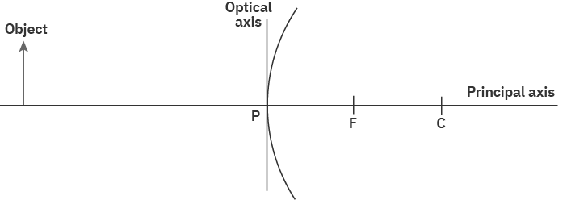
Once we have the axes of a ray diagram set up we can add the object and start to determine its reflected image.
The object is generally placed to the left of the optical axis and is represented by a vertical arrow, pointing upwards. This will make it much easier to determine the nature of the image.
The object is usually placed in relation to the properties of the mirror. For our first example, we will place the object far away from the mirror. This means the object is placed near the left-hand end of the principal axis.

Slide 10
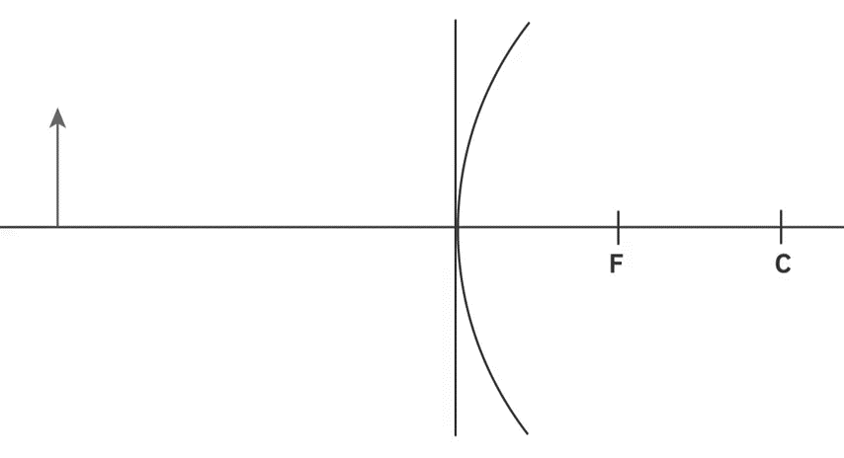
Now that we have set up our ray diagram, we can use three principal rays to determine the position of the image produced by a convex mirror.
The first principal ray we consider will start at the top of the object. It will then travel parallel to the principal axis until it reaches the optical axis (the mirror). As it reflects from the mirror it will appear as though it has travelled from the focus behind the mirror (where all the reflected rays of incident parallel rays will converge) and continue on beyond the ray diagram.
When drawing this principal ray on a ray diagram we need to ensure that the section of the reflected ray that is behind the mirror (from the virtual focus to the edge of the mirror) is drawn with a dotted line while all other rays are drawn as solid lines.

Slide 11
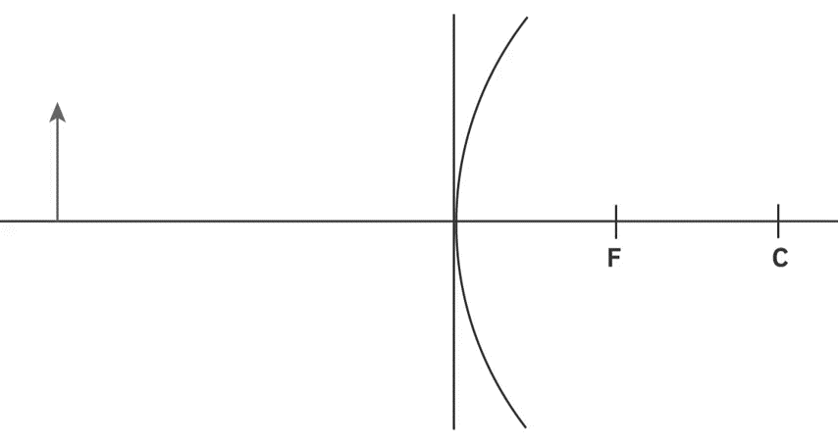
The second principal ray we will consider is the reverse process of the first principal ray.
The second principal ray will also start at the top of the object. It will travel to the mirror towards the focus behind the mirror. However, once it reaches the mirror it will get reflected back from the mirror, parallel to the principal axis.
Drawing this principal ray, we place our ruler joining the top of the object to the focus behind the mirror. However, our incident ray is only drawn up to the mirror. The reflected ray is then drawn parallel to the principal axis.

Slide 12
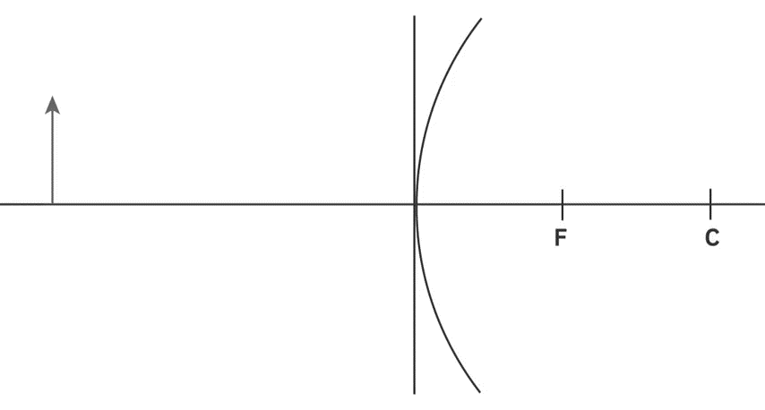
The third principal ray we will consider uses the law of reflection.
The third principal ray starts at the top of the object (the same as the two previous rays). It then travels from the top of the object to the pole (centre) of the mirror. The centre of a convex mirror can be approximated as a plane mirror, thus we can use the law of reflection to understand what will happen to this ray.
The law of reflection states that the angle of incidence equals the angle of reflection. Thus, the angle between the incident ray and the principal axis will be the same as the angle between the reflected ray and the principal axis.

Slide 13

To determine the location of the image we need to combine three principal rays onto one diagram.
As we draw on three principal rays (always starting from the top of the object) we notice that there is no point at which all three reflected rays converge. This indicates that we cannot form a real image with a convex mirror. However, we can create a virtual image.
A virtual image is formed from virtual light rays and will not be able to be seen on a screen. We will only be able to observe a virtual image when we look into the mirror and it will appear to be placed behind the mirror.

Slide 14
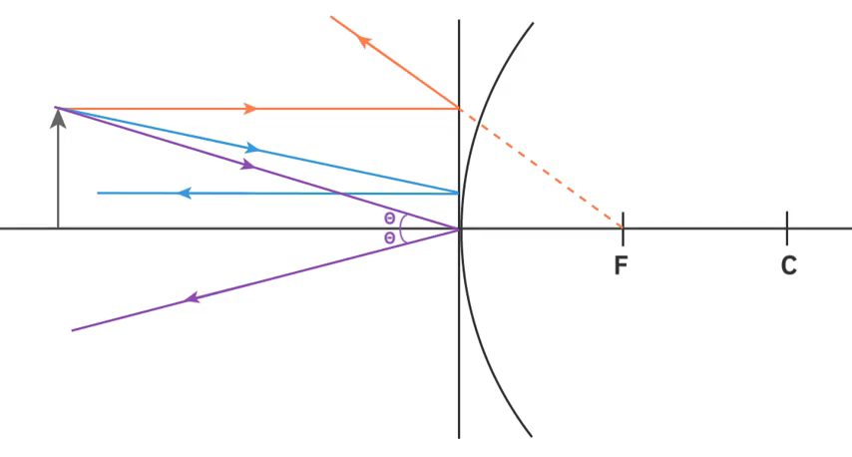
To locate a virtual image, we backtrace the reflected principal rays.
This means we find the location where the reflected principal rays meet the convex mirror and trace them behind the mirror, making sure to keep the same angles for our lines. When we trace rays behind the mirror, creating virtual rays, it is referred to as backtracing and the rays are drawn using dotted lines. Only two of the principal rays need to be backtraced as the third one has already been backtraced.
There is a point behind the mirror where the three backtraced rays (virtual rays) converge. This point of intersection identifies the top of the virtual image. We can draw a vertical line from this location back to the principal axis to show the formation of the virtual image. This image has formed between the edge of the mirror and its focus.

Slide 15
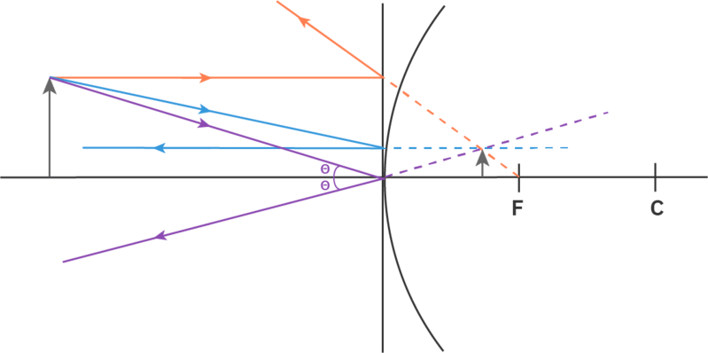
It is not enough just to show the location of the image on a ray diagram. Often we also need to describe the nature of the image, consisting of three different properties.
In the ray diagram below, we can see that the image has the same orientation as the object, as both arrows point upwards. We refer to this as an upright image. The image has been formed by virtual light rays and is therefore referred to as a virtual image. It turns out virtual images are always upright and upright images are always virtual.
Lastly the image in the ray diagram below is smaller than the object. This is referred to as a diminished image. Thus, the nature of this image is virtual, upright and diminished.

Slide 16
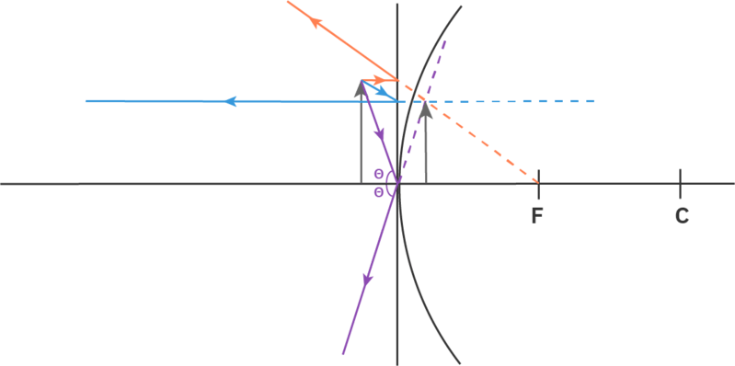
A convex mirror always creates a virtual, upright and diminished image.
Regardless of the object location with respect to a convex mirror a virtual, upright and diminished image is always formed between the edge of the mirror and its focus.
Although the image remains diminished, as we move the object closer to the mirror the size of the image increases. In the ray diagram below, we have placed the object just in front of the mirror and the image formed is almost the same height as the object.

